Slide 1

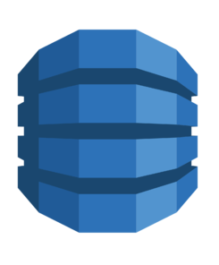


Serverless Backend Demo
Lambda
DynamoDB
API Gateway

Slide 2
Demo Brief
Background information - JSON, REST, boto3
DynamoDB primer
Creating a Lambda Function (and what it is)
Purpose of an API Gateway

Slide 3
JSON
JavaScript Object Notation - a format for exchanging text based information
A key-value pair structure that is very similar to dict objects in Python
Utilised by most modern APIs to send and receive data
Very human readable but powerful notation
{
"name": "Gautham",
"age": 22,
"favourite_foods": ["Curry", "Xiaolongbao"],
"favourite_cars": [{
"make": "Honda",
"model": "Integra"
},
{
"make": "McLaren",
"model": "F1"
}
]
}

Slide 4
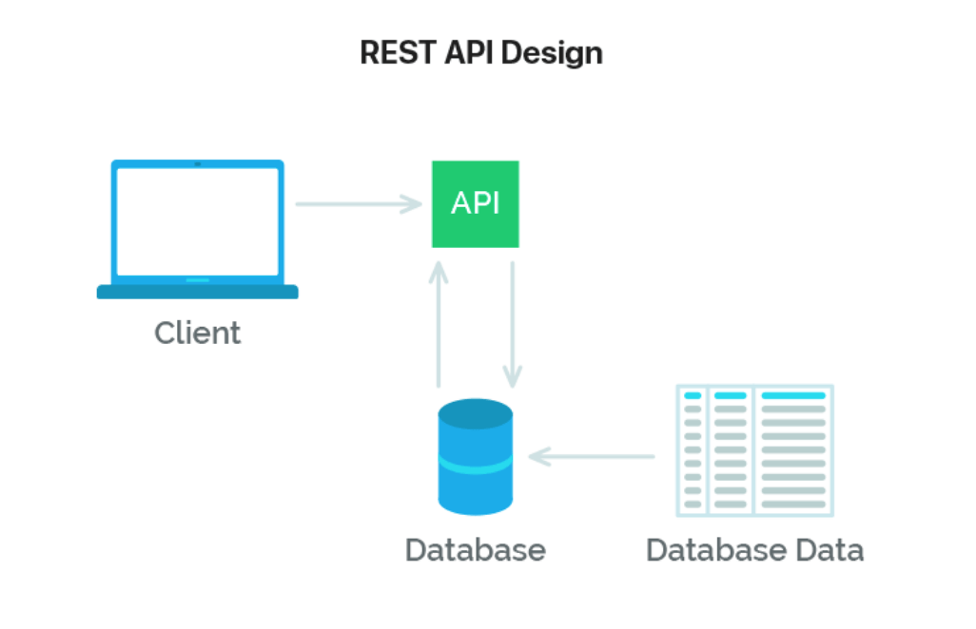
REST API
A set of endpoints provided by a web service that provides an interface for consumers to interact with the service
Generally uses JSON payloads as a method of sending and receiving data

Slide 5
REST API – getting technical
API’s are accessed by the following aspects
URL – can sometimes contain parameters (http://api.com vs http://api.com?query=teehee)
HTTP Method - GET, POST, PUT, DELETE
Lets look at an example - https://petstore.swagger.io/

Slide 6
AWS SDK (boto3)
Rather than clicking on the AWS website to do things, you can programmatically do it via REST API calls
Boto3 is used to easily perform REST API calls to AWS services
E.g. add a new database entry (add details about Toy Story 2)
E.g. modify a database entry (delete entry for The Last Airbender movie)
https://boto3.amazonaws.com/v1/documentation/api/latest/index.html

Slide 7
DynamoDB
What is a database – persistent information storage
NoSQL vs SQL – strict vs fluid entries
Live Demo
Creating a database
Adding Entries
Adding entries programmatically
import boto3
dynamodb = boto3.resource('dynamodb')
table = dynamodb.Table('kanye_quotes')
response = table.put_item( Item={'quote': 'Some random quote'} )

Slide 8
Lambda Functions and AWS API Gateway
Store code on AWS
Pay for executions rather than for a server
Serverless – you don’t need to host a server (e.g. running code on your computer utilises your computer as a server)
Problem: How to easily trigger a Lambda Function
Solution: AWS API gateway - give the Lambda function a URL and a HTTP method to trigger it
What have we achieved: Serverless REST API backend

Slide 9
Lets Create One
GET - a Kanye Quote (just get a random one)
POST – upload a quote to the database
Notes for Gautham: Set AWS Roles, CloudWatch

